Slide 1
FoP PROJECT
INITUITATIVE GAME DEVELOPEMNT

Slide 2




MIGHTY PYTHONS
GROUP DESCRIPTION:
HAFSA MALIK
HAFSA TARIQ
SADIA REHMAN
ZAINAB ANWAAR
(341303)
(341567)
(332198)
(339636)

Slide 3
DETAILED IDEA:
.
Zombie Dash is a captivating multi-level game that encompasses the themes of adventure and survival. It’s a Python based game in which the user assumes the role of the player and attempts to survive a zombie apocalypse.\
The game begins at the player’s office where he’s informed about the fierce onslaught of zombies in the local area. In such deadly conditions the player must escape and reach the underground shelter or else be devoured by the savage brain-deads.
But, safety doesn’t come easy in a situation like this. Through this journey, the player encounters many levels accompanied by different challenges . The player has to play a variety of games, testing his nerves, to be able to enter places to keep up his energy level and only by passing by each level can the player retreat to safety.

Slide 4
LEVELS:
.
STAGE 1
STAGE 2
STAGE 3
STAGE 4
The adventure starts with the player being stuck in the elevator of the office building. In order to escape, one has to play a quiz game that ranges from easy to hard questions. In case of correct answers, the next level is unlocked.
In the second stage, the player has to advance through the town and reach their home to pick up supplies. For the sake of entering, a game of cards needs to played.
Next, the player proceeds towards the abandoned supermarket and engages in a game of rock paper scissors to gather food supplies.
Having gathered the food supplies, the player must move to the underground bunker where all the other survivors are seeking refuge. But, to reach complete safety the player will go through one last challenge that would be guessing the password to the bunker.

Slide 5

FEATURES OF ZOMBIE DASH:
GENRE
Game Mode
TARGET AUDIENCE
Continuous challenges
GRAPHICAL USER INTERFACE
Adventure based Survival
Single Player multi-level Game
Zombie Dash is not aimed at a specific audience rather by adding challenges from easy to hard level we are aiming to attract people from different age groups.
We have added multitude of mini games at each level to keep the player hooked up.
GUI Provides a user friendly interface to the player, making the game clear and attractive with bright imagery.

Slide 6
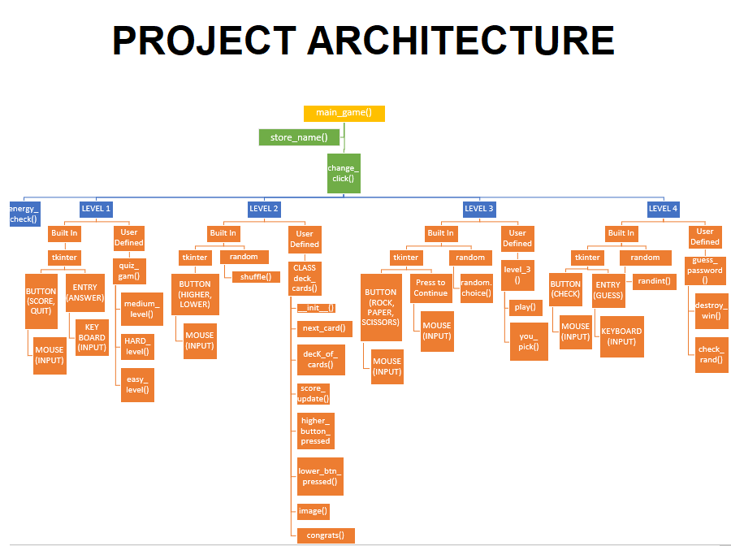
PROJECT ARCHITECTURE DIAGRAM:
.

Slide 7
DEMO

Slide 8
CONTRIBUTIONS:
HAFSA TARIQ
SADIA REHMAN
Made the module quiz_game()-(Level1)
Completed the documentation of code.
Made GUI interface for the specified module.
CLASS :DeckOfCards()- (Level2).
Uploaded the project on Github.
Made GUI interface for the specified class.

Slide 9
CONTRIBUTIONS:
HAFSA MALIK
ZAINAB ANWAAR
MODULE: RockPaperScissor() (Level3)
Compilation of code.
Made GUI interface for the specified module.
Made GUI interface and Graphics for the main game window.
MODULE: Guess_Password() (Level4)
Made Graphics for the main Window
Made GUI interface for the specified module.
Made final presentation.

Slide 10

THANK YOU

